Slide 1
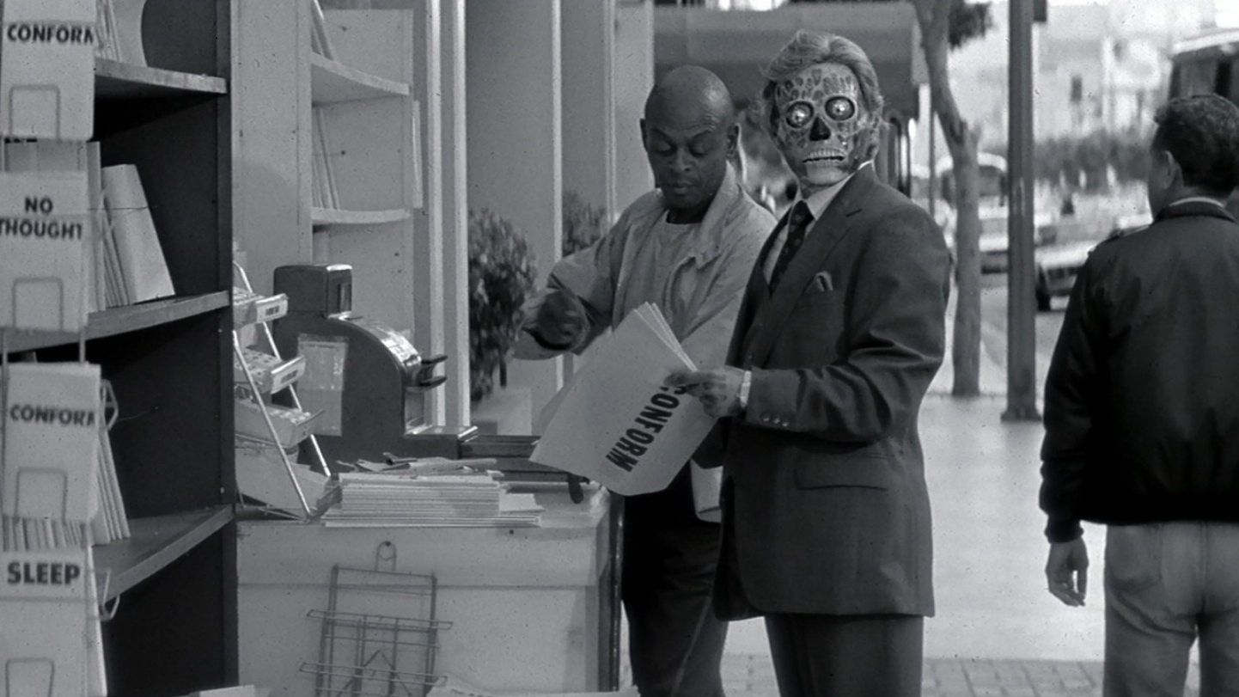
THEY LIVE
The super official board game

Slide 2
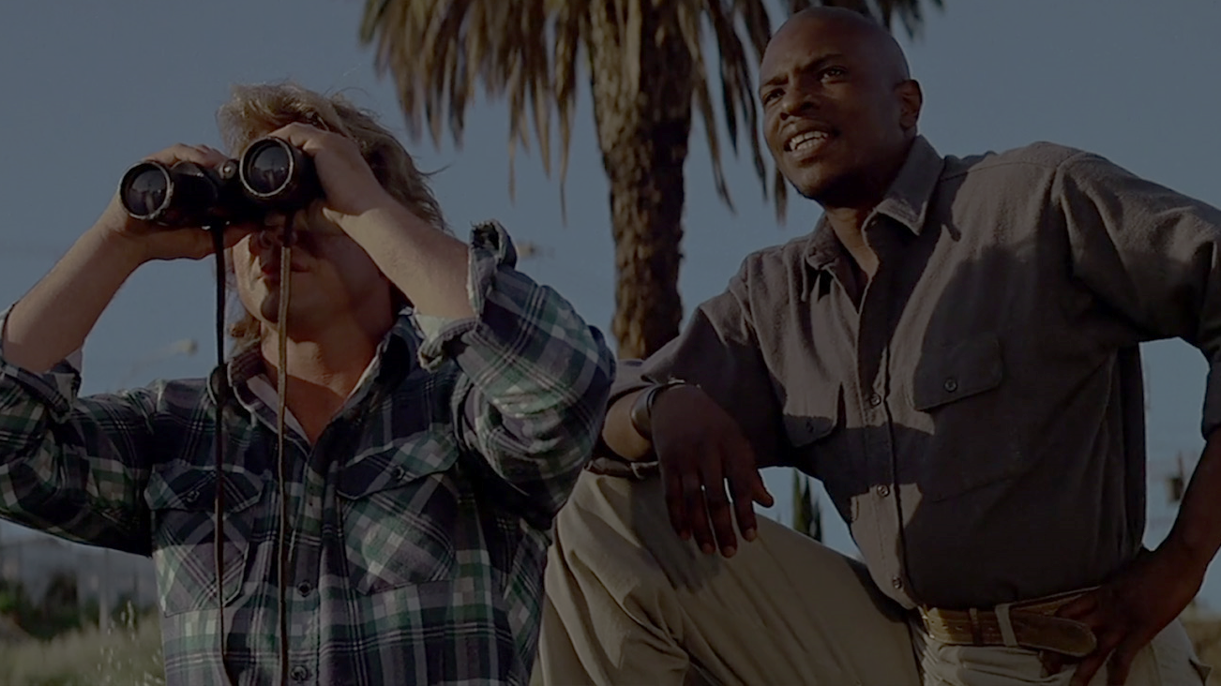
WHAT THE HELL IS ‘THEY LIVE’?
1988 “horror” film about the underlying issues of yuppies, unrestrained capitalism and acts as a critique of Reaganomics

Slide 3
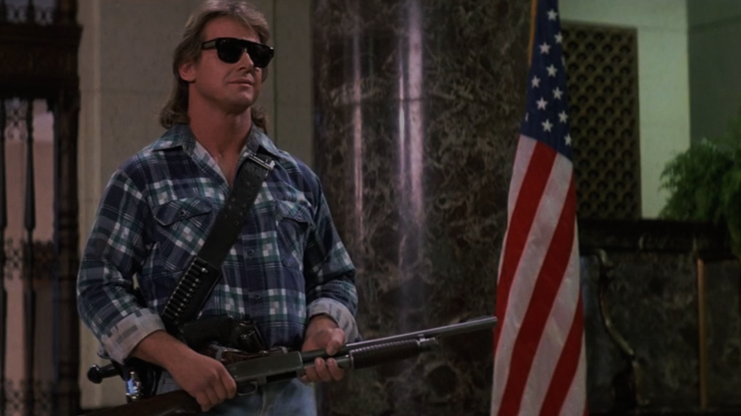
WHAT’S IT REALLY ABOUT?
WWE hall-of-famer Roddy Piper teams up with Hollywood all-star Keith David.
Using special shades, they take on a secret society of hypnotising aliens the only way they know how

Slide 4
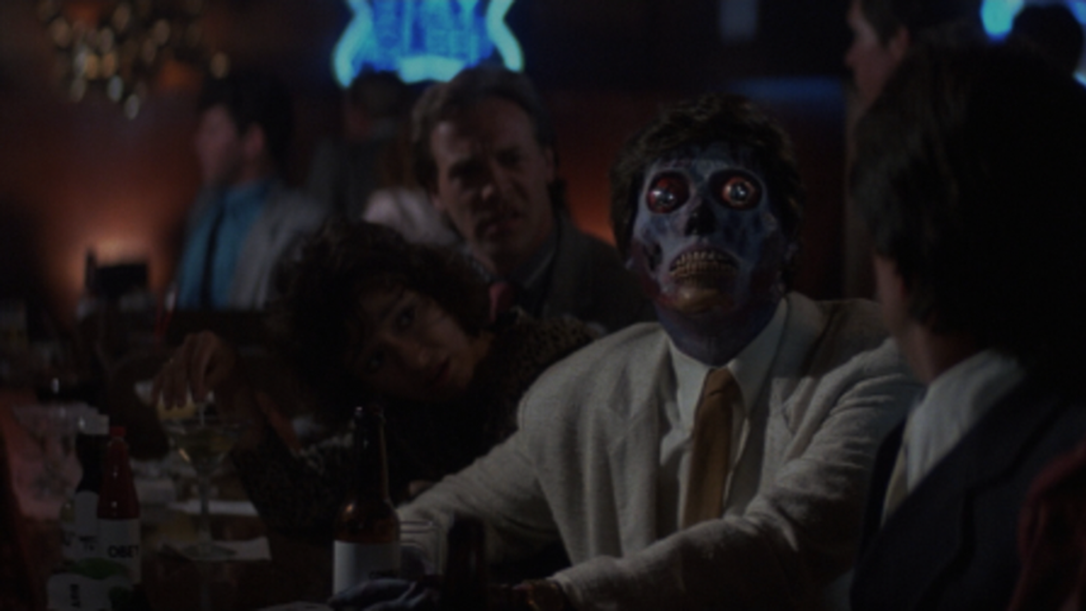
COOL MOVIE, BUT WHAT KIND OF GAME IS IT?
Co-op / PvP game for up to 4 players
Move around a modifiable board collecting cash to fund a hostile takeover
Too much exposure to hypno leads to siding with the aliens!

Slide 5
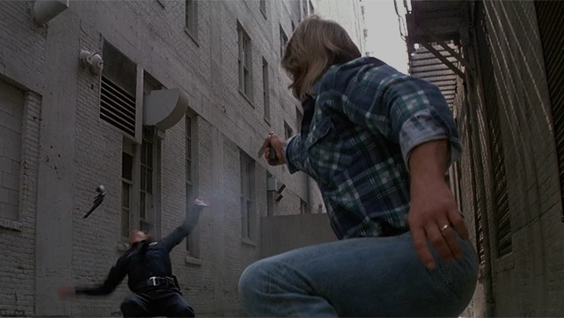
I LIKE MY HUMANITY
Don the super shades and fight back against an alien threat
Use their own weapons against them
Overthrow the secret society by funding a human resistance!

Slide 6
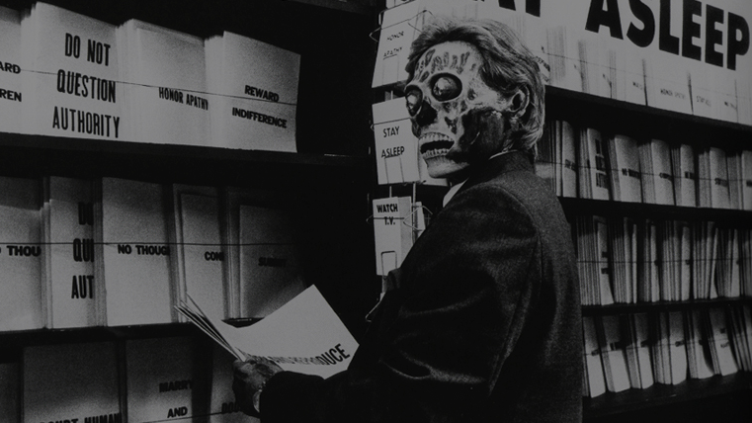
LETS GET EXTRATERESTRIAL
Hypnotise others using your Secret stash of advanced cards
Stop the revolution before it ever begins
Maniacally laugh in the face of oppression

Slide 7
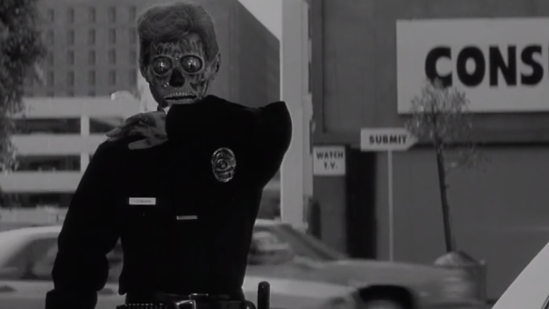
SO HOW DO I PLAY IT? 3 PHASES
Phase 1 :
Everyone starts as humans
Collect as much money while avoiding hypno
Too much hypno = Player becomes an alien

Slide 8
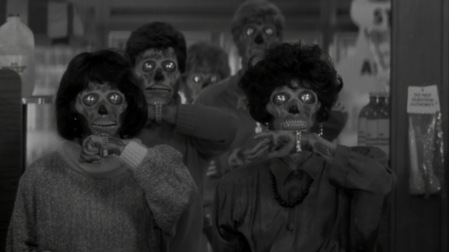
I’VE BECOME AN ALIEN, BUT WHAT NOW?
Phase 2:
Aliens place super hypno cards strategically around the map
Humans must continue funding the resistance
Confrontation between both sides possible

Slide 9

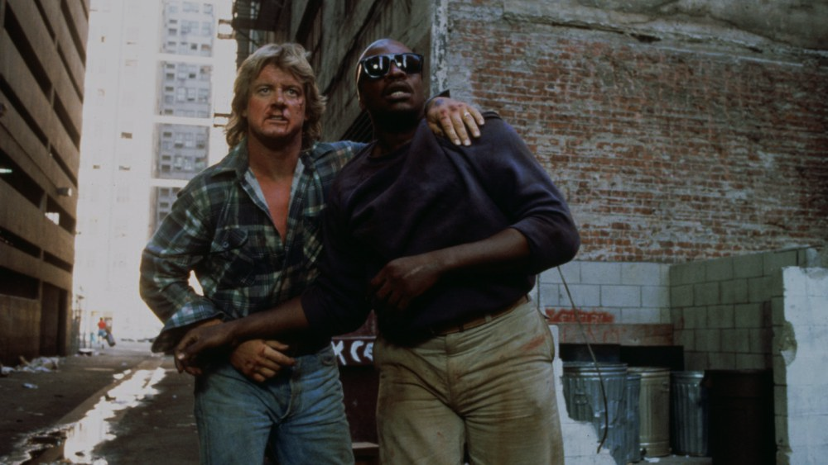
HOW CAN I WIN?
Phase 3:
Resistance funded? Head to the alien-marked spot to win!
Aliens have to protect the spot or face annihilation!

